Slide 1
LANDFIRE: Foundational data used to support Cohesive Strategy Goals
Inga La Puma* LANDFIRE Technical Lead *KBR, contractor to the U.S. Geological Survey (USGS) Center for Earth Resources Observation and Science (EROS),
Sioux Falls, South Dakota Work performed under USGS contract 140G0121D0001

Slide 2
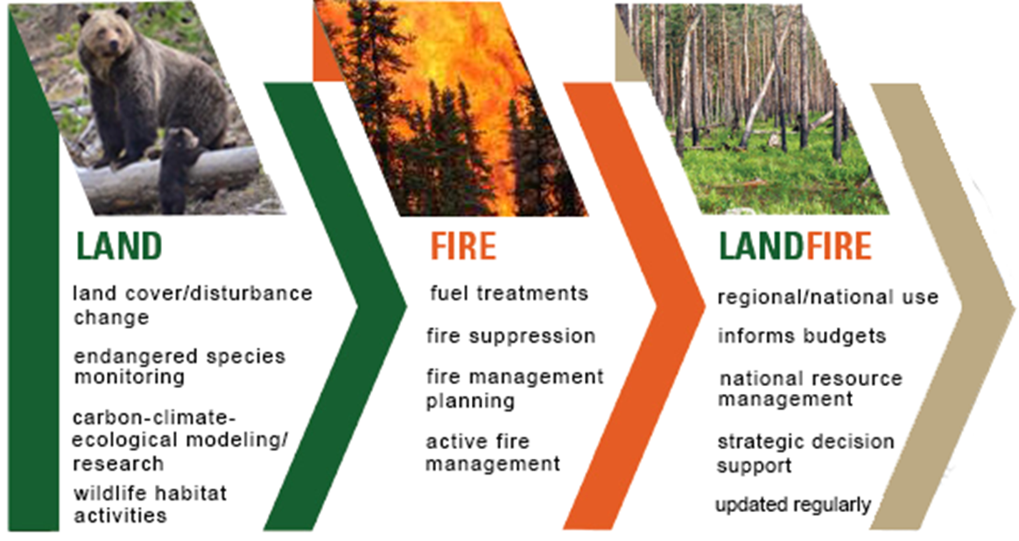
LANDFIRE Overview
In 2002, GAO reported,
"Data are not available to better prioritize communities and projects for funding" and "On the basis of our review, LANDFIRE is the only proposed research project so far that appears capable of producing consistent national inventory data for improving the prioritization of fuel projects and communities." (GAO-02-259)
Notes:
Landscape Fire and Resource Management Planning Tools Project, prototype out of Missoula fire lab
Chartered by: Wildland Fire Leadership Council in 2004
National mapping program funded by USFS and DOI- office of wildland fire, TNC partners, and USGS runs the contract
In response to Congressional / GAO direction to produce consistent national inventory data for improving the prioritization of fuel projects and communities.

Slide 3
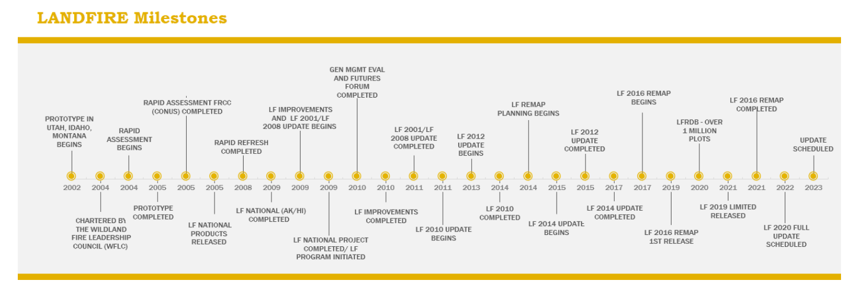
LANDFIRE through the years
Base maps: Machine learning models
Updates: Rulesets to account for disturbance
Notes:
Going on 20 years since the prototype for LANDFIRE began. Done with LF2020. Goal is to make our updates work more like the base map methodology and account for the disturbances experienced the year before in the next release. LF2022 will be released in 2023.

Slide 4
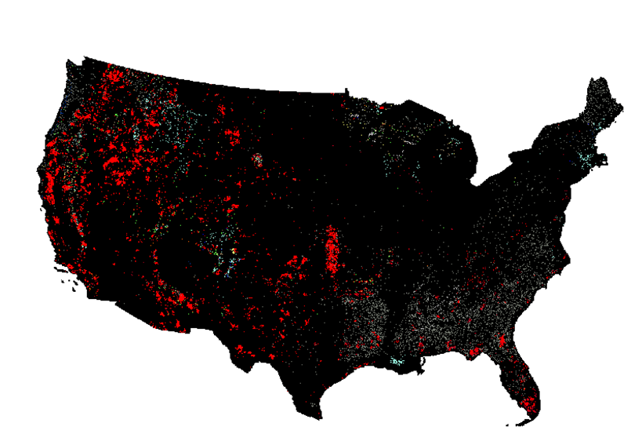
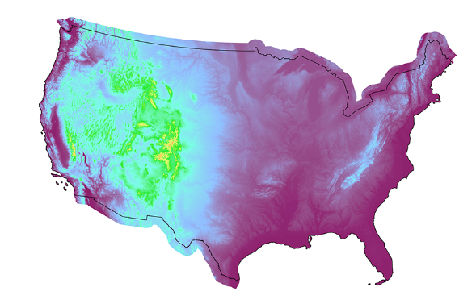
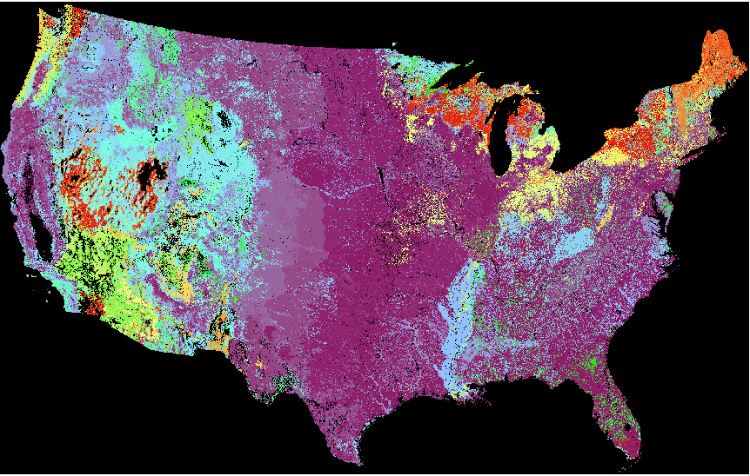
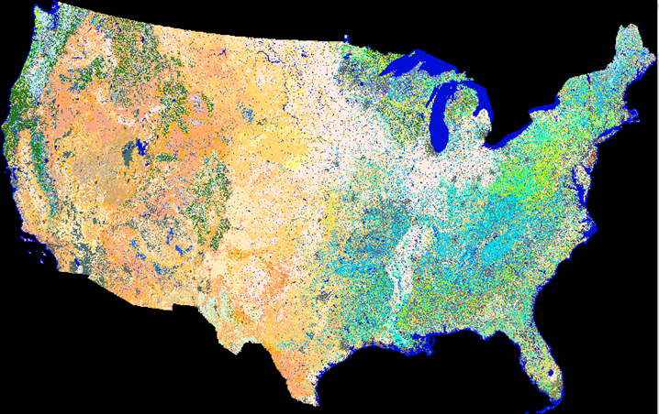
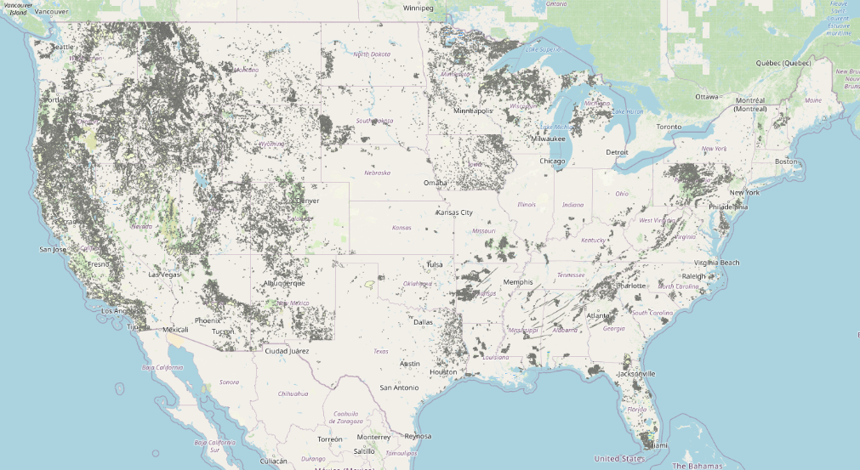
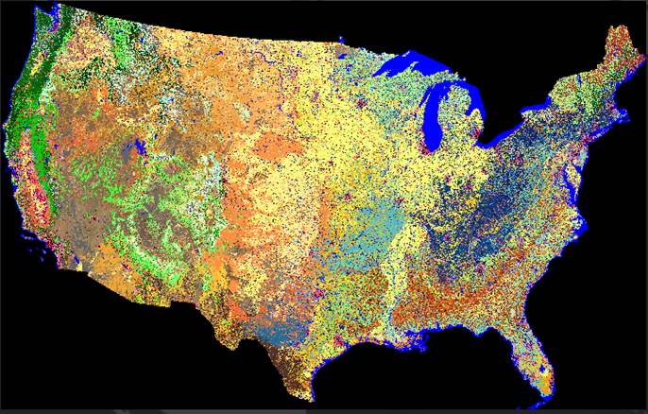
LANDFIRE layers
All lands in United States and insular areas at the 30m pixel level
Disturbance
Annual (every year)
Historical Disturbance (10 years)
Fuel Disturbance
Topographic
Slope (deg)
Slope (%)
Aspect
Elevation
Vegetation
Existing Vegetation Type (ES and NVC)
Existing Vegetation Cover Existing Vegetation Height
Biophysical Settings
Fuels
13 Anderson Fire Behavior Fuel Models
40 Scott and Burgan Fire Behavior Fuel Models
Fuel Characteristic Classification System
Canopy Cover
Canopy Height
Canopy Bulk Density
Fuel Vegetation Type
Fuel Vegetation Cover
Fuel Vegetation Height Mod-FIS
Fire Regime
Succession Class
Vegetation Departure Index
Vegetation Condition Class
Fire Regime Group
Fire Return Interval
Percent Replacement Severity Fire
Percent Mixed Severity Fire
Percent Low Severity Fire
Reference
Reference Database (plots)
Events Geodatabase (polygons)
Notes:
Over 30 spatial data layers. My job to keep track of all of these how they are created and relate! Note dependencies.
24 raster layers if you count only one year of annual disturbance and you count nvc from remap. If you count three mod-fis releases per year add three layers. If you count the fire regime layers separately add 5 (they are not currently separate from bps). Then add two for events geodatabase and lfrdb if you are counting non rasters layers.

Slide 5
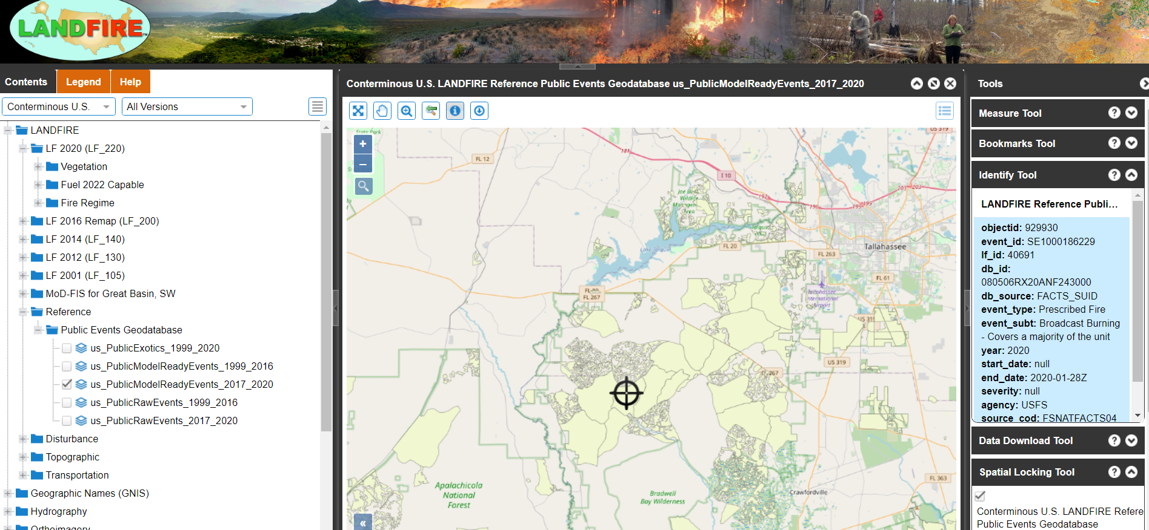
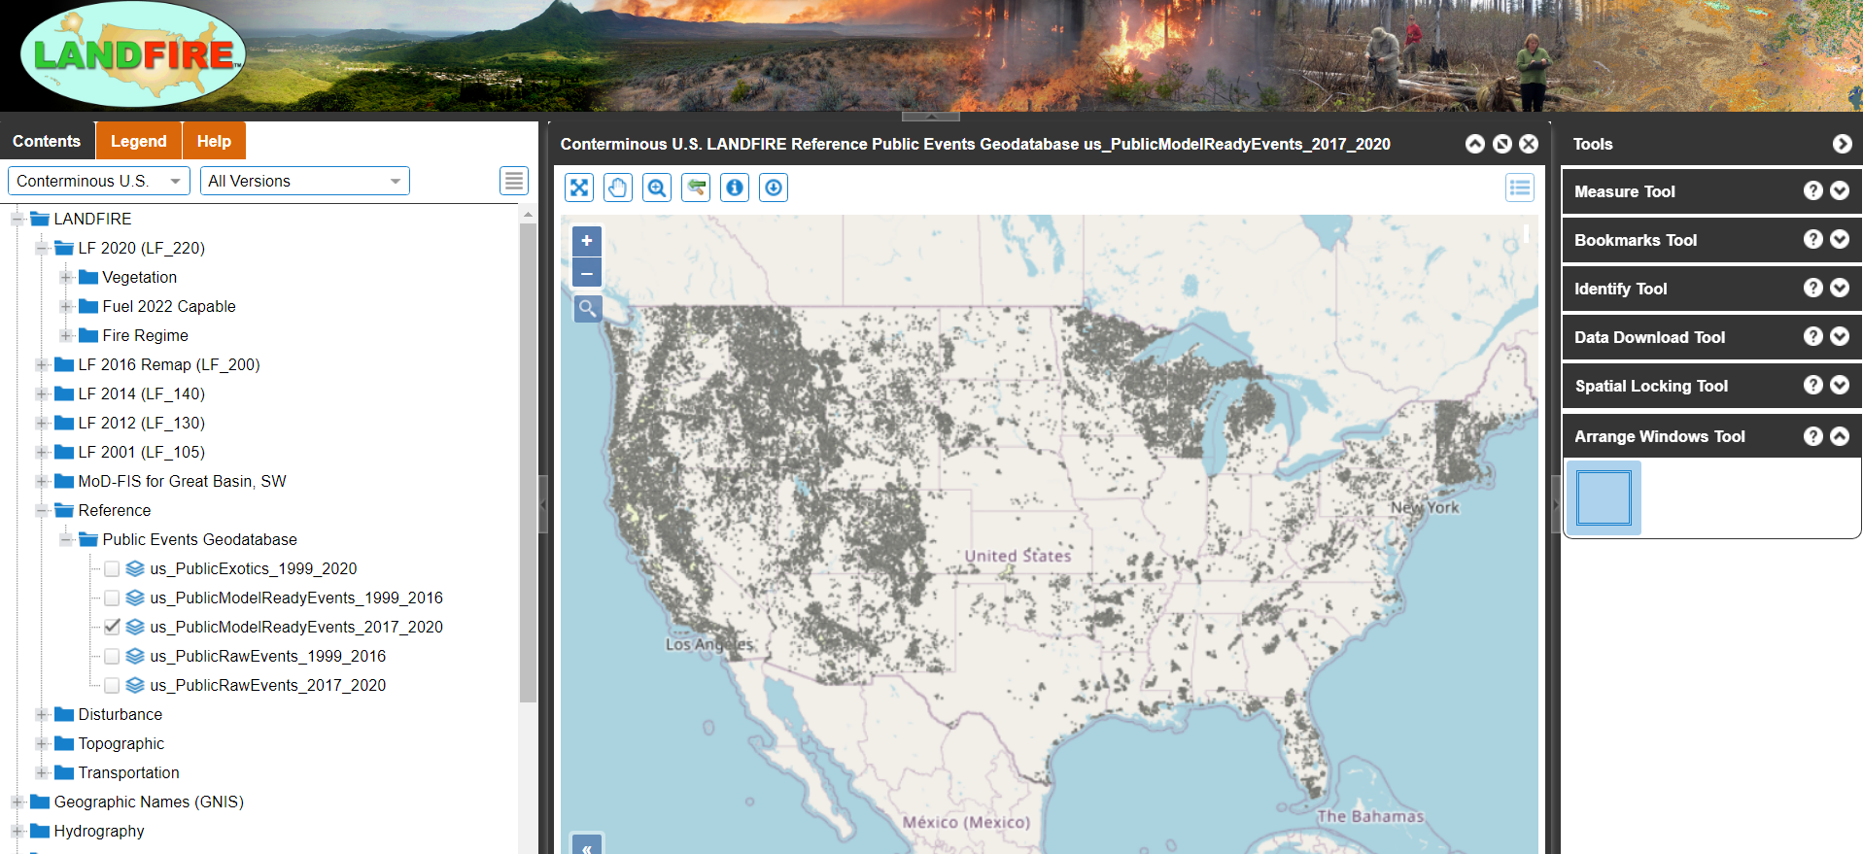
Reference: Events Geodatabase
Notes:
Glimpse of our viewer and data download system. Vector geodatabase. Have a process– for standardizing format and hierarchy based on source etc. Put a call out for data by Oct 30th of each year.- Work by NE liaison and you can see that evidence.

Slide 6
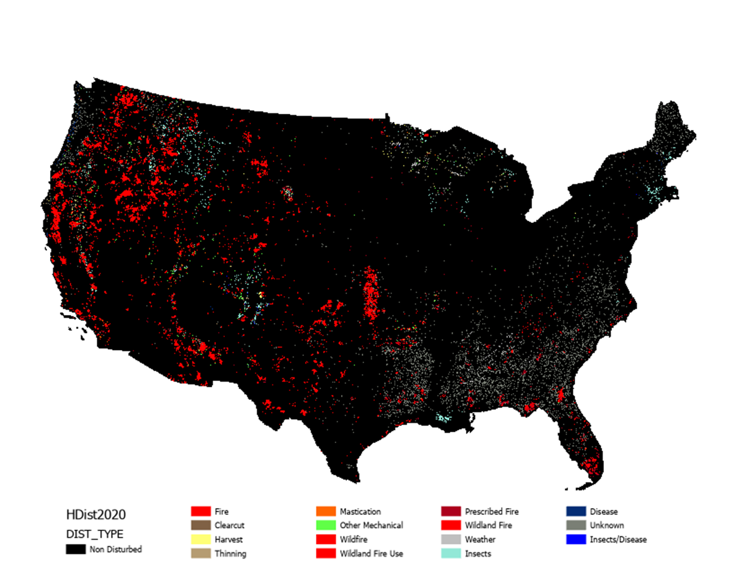
Disturbance: Annual/Historical
Notes:
Raster/pixel based (30m) with attributes for each pixel telling you the cause, how it was derived, severity, general confidence etc. Explain acronyms. Other national fire mapping products.

Slide 7
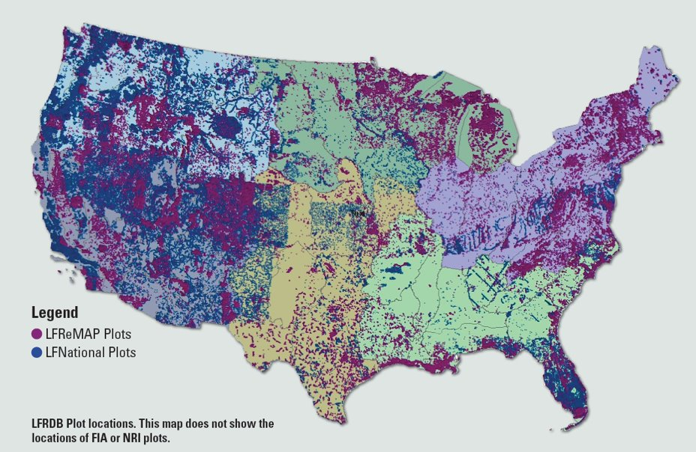
Reference: LF Reference Database
Notes:
XY point locations (over our geoArea regions) with species and cover – used to train our ML models for mapping vegetation type cover and height – great resource for AI/ML applications.

Slide 8
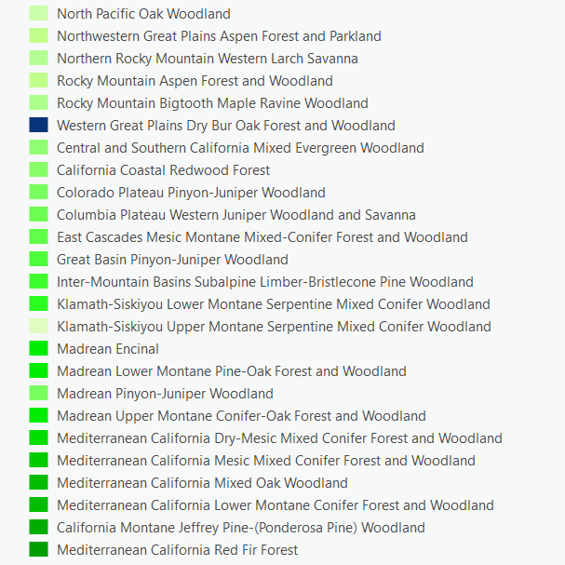
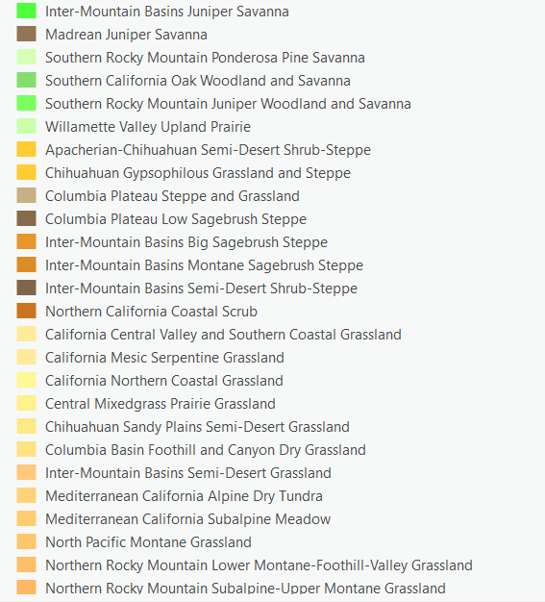
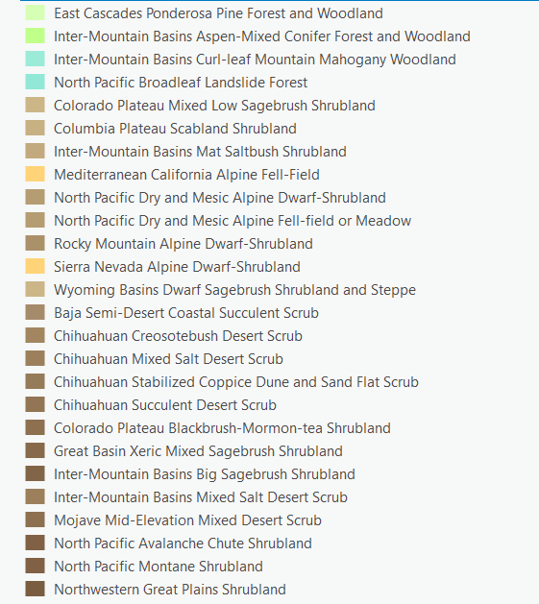
Vegetation: Existing Vegetation Type (EVT)
EVT- Ecological Systems (ES) Classes
EVT- National Vegetation Group Classes (NVC)
Type | CONUS | Alaska | Hawaii | Insular Areas
Developed | 25 | 4 | 4 | 4
Agriculture | 39 | 2 | 4 | 2
Modeled Natural | 703 | 118 | 29 | 54
-Tree | 339 | 37 | 10 | 28
-Shrub | 145 | 42 | 10 | 9
- Herb | 157 | 26 | 6 | 7
- Sparse | 62 | 13 | 3 | 10
Modeled Ruderal | 35 |  | 5 | 15
-Tree | 8 |  | 3 | 5
-Shrub | 12 |  |  | 5
-Herb | 15 |  | 2 | 5
Modeled Cultural | 2 |  |  | 3
Developed Ruderal | 40
Recently Disturbed | 9
Other (water, snow/ice) | 2 | 2 | 1 | 1
Total | 849 | 118 | 38 | 73
Type | CONUS | Alaska | Hawaii | Insular Areas
Developed | 25 | 4 | 4 | 4
Agriculture | 39 | 2 | 4 | 2
Modeled Natural | 395 | 39 | 24 | 45
- Herb | 93 | 8 | 6 | 6
- Shrub | 113 | 14 | 7 | 9
- Sparse | 34 | 7 | 4 | 9
- Tree | 155 | 10 | 7 | 21
Modeled Ruderal | 35 |  | 5 | 14
- Herb | 15 |  | 2 | 5
- Shrub | 12 |  |  | 5
- Tree | 8 |  | 3 | 4
Modeled Cultural | 2 |  |  | 2
Developed Ruderal | 40
Recently Disturbed | 9
Other (water, snow/ice) | 2 | 2 | 1 | 1
Total | 541 | 39 | 33 | 62
Notes:
EVT – ES number of classes mapped vs. EVT-NVC number of classes mapped. Here are about 75 of the ES classes, about 10% of natural veg classes available.

Slide 9
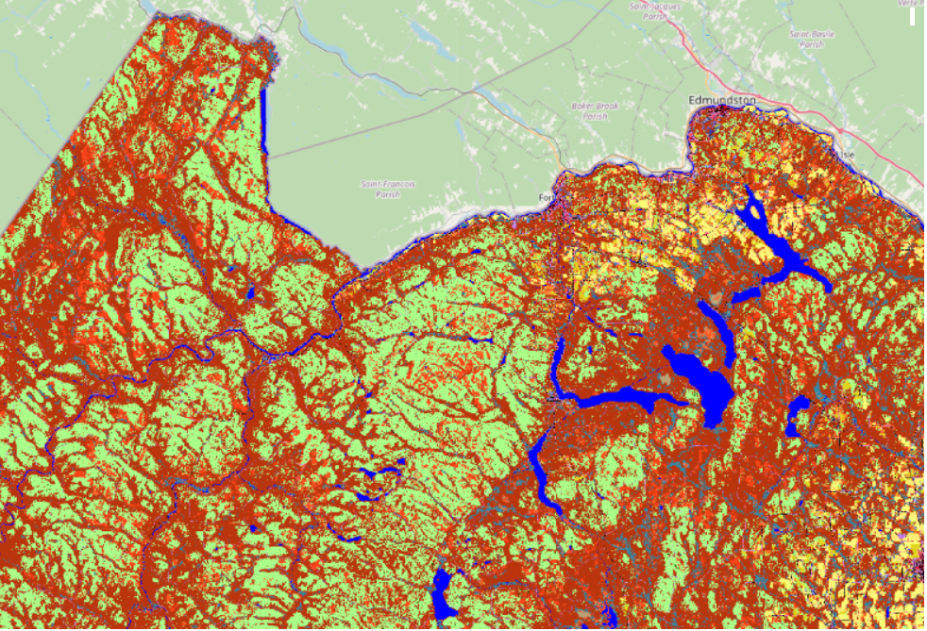
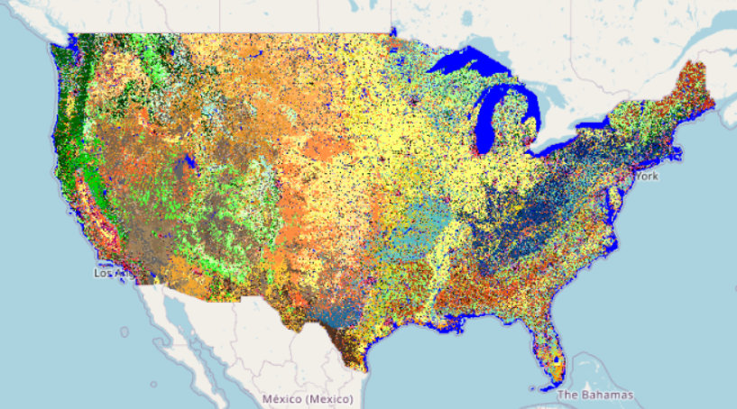
Vegetation: Existing Vegetation Type (EVT)
EVT- Ecological Systems (ES) Classes
Notes:
Data is refined enough that you can use at more moderate or local scale.

Slide 10
Mapping is modeling
LANDFIRE uses machine learning to extrapolate across the landscape
LANDFIRE trains models with real plot and lidar data
Notes:
Before we get into the details of our cover and height raster/pixel-based layers – remind everyone that mapping is modeling…. Nobody has real world information for every 30m pixel of the country and so mapping is a science. GEDI is helping, but there are still challenges.

Slide 11
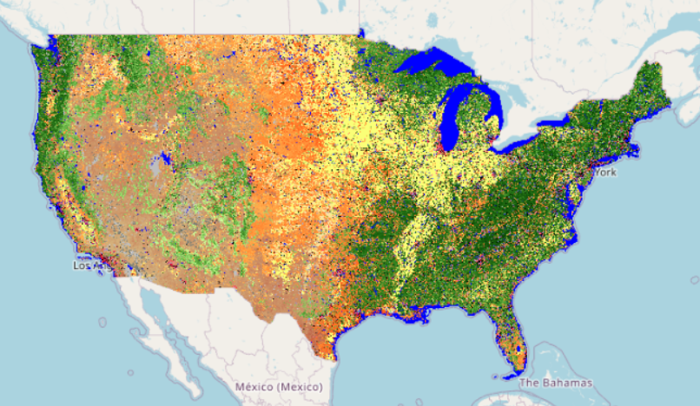
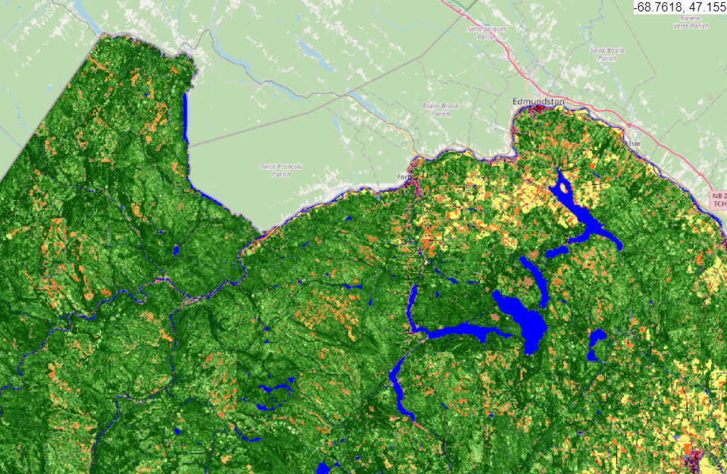
Vegetation: Existing Vegetation Cover (EVC)
Continuous values between 0-100% for herbs, shrubs and trees
Notes:
Point out green for trees, yellow for crop. Orange for herbaceous, and brown for shrub.

Slide 12
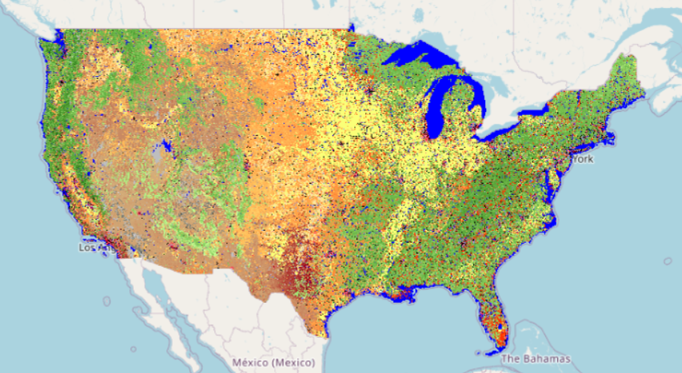
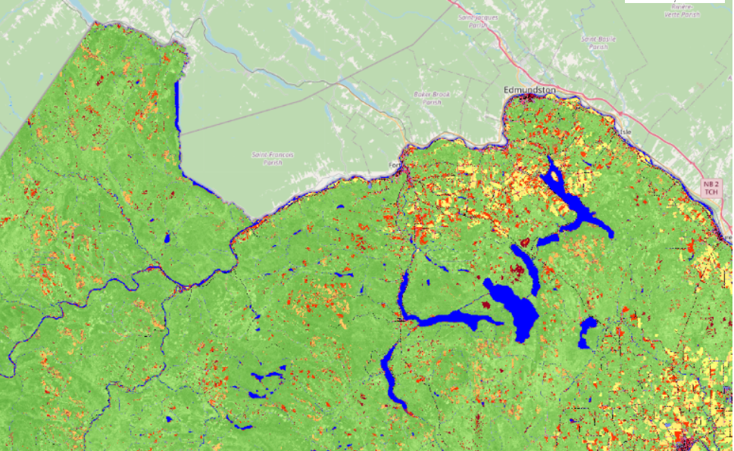
Vegetation: Existing Vegetation Height (EVH)
Continuous values between 0-100m for herbs, shrubs and trees
Notes:
Point out green for trees, yellow for crop. Orange for herbaceous, and brown for shrub.

Slide 13
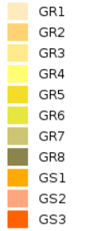
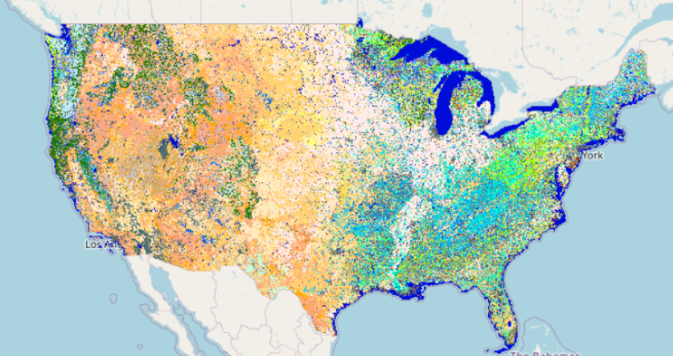
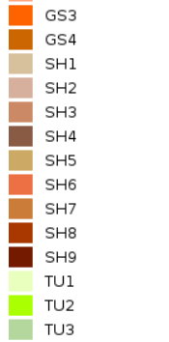
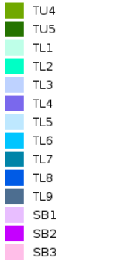
Fuel: Fire Behavior Fuel Model 40 (FBFM40)
Surface fuel models describing how rate of spread and flame length changes with fuel moisture
Notes:
Describe difference between FBFM40 and fire behavior models.

Slide 14
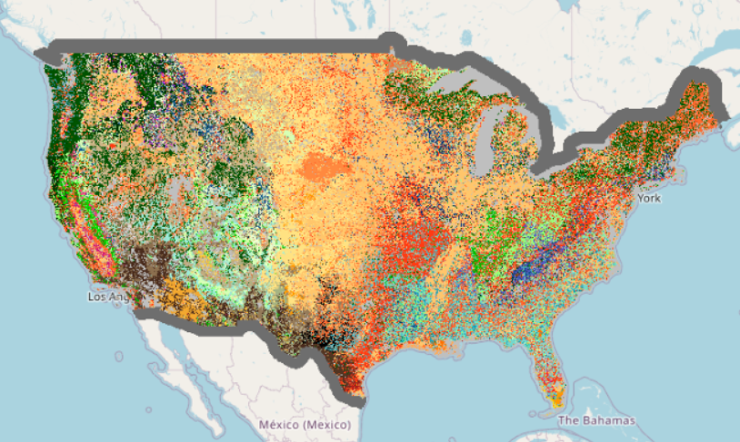
Fuel: Fuel Characteristic Classification System (FCCS)
Fuel models describing fuel loading across strata
Notes:
Used in smoke models

Slide 15
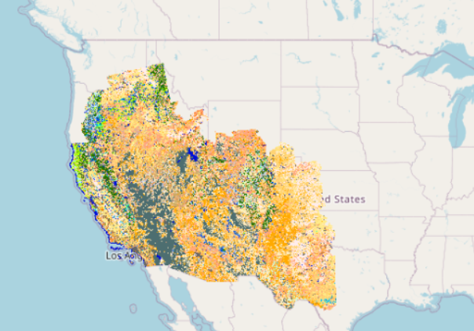
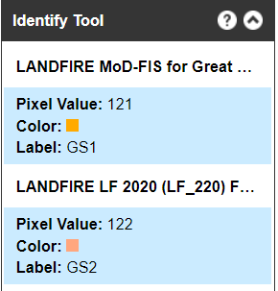
Fuel: Seasonal Mod-FIS
Adjusted herbaceous fuel models for the Great Basin and Southwest released Spring, Summer, Fall
GS1 Shrubs are about 1-foot high, low grass load. Spread rate moderate; flame length low.
GS2 Shrubs are 1 to 3 feet high, moderate grass load. Spread rate high; flame length moderate.

Slide 16
LANDFIRE layers
All lands in United States and insular areas at the 30m pixel level
Disturbance
Annual (every year)
Historical Disturbance (10 years)
Fuel Disturbance
Topographic
Slope (deg)
Slope (%)
Aspect
Elevation
Vegetation
Existing Vegetation Type (ES and NVC)
Existing Vegetation Cover Existing Vegetation Height
Biophysical Settings
Fuels
13 Anderson Fire Behavior Fuel Models
40 Scott and Burgan Fire Behavior Fuel Models
Fuel Characteristic Classification System
Canopy Cover
Canopy Height
Canopy Bulk Density
Fuel Vegetation Type
Fuel Vegetation Cover
Fuel Vegetation Height Mod-FIS
Fire Regime
Succession Class
Vegetation Departure Index
Vegetation Condition Class
Fire Regime Group
Fire Return Interval
Percent Replacement Severity Fire
Percent Mixed Severity Fire
Percent Low Severity Fire
Reference
Reference Database (plots)
Events Geodatabase (polygons)
Notes:
I just highlighted a few of our layers, but this slide is to remind you that there are many that I did not highlight and they all have their own mapping processes, many of which are interrelated with other LF layers.

Slide 17
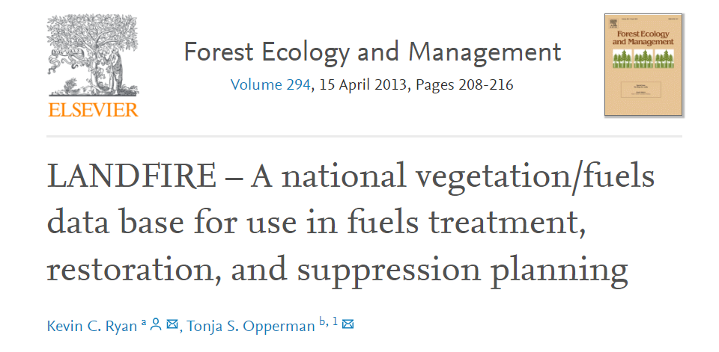
CS and LANDFIRE
“LANDFIRE has been institutionalized as the primary data source for modeling activities aimed at meeting the goals of the United States’ National Cohesive Wildland Fire Management Strategy”
Notes:
11 years after the first LF prototype – LANDFIRE is institutionalized. Pros and cons for this. Make the authors bigger

Slide 18
Overview
Restore and Maintain Landscapes
What is the situation?
Spatial context Relative risk
Fire Adapted Communities
What can I do about it?
Local conditions Community engagement
Response to Fire
Who can help me? Help from outside Operational decisions
Notes:
Resilient landscapes.

Slide 19
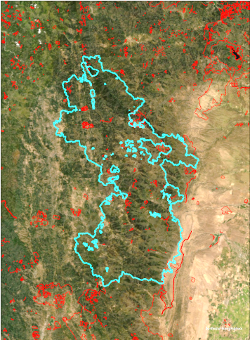
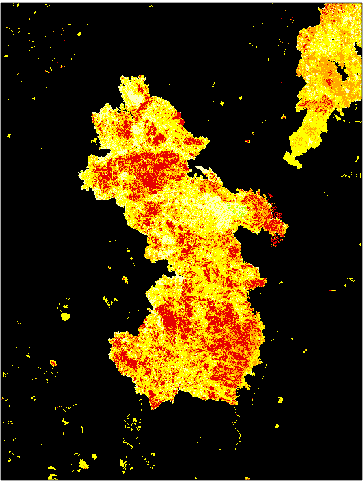
What is the situation? Spatial Context
Events
Annual Disturbance
Notes:
August complex from 2020, events geodatabase, annual 2020 disturbance layer with severity from MTBS surrounding landscape with events and remote sensing derived disturbances.

Slide 20
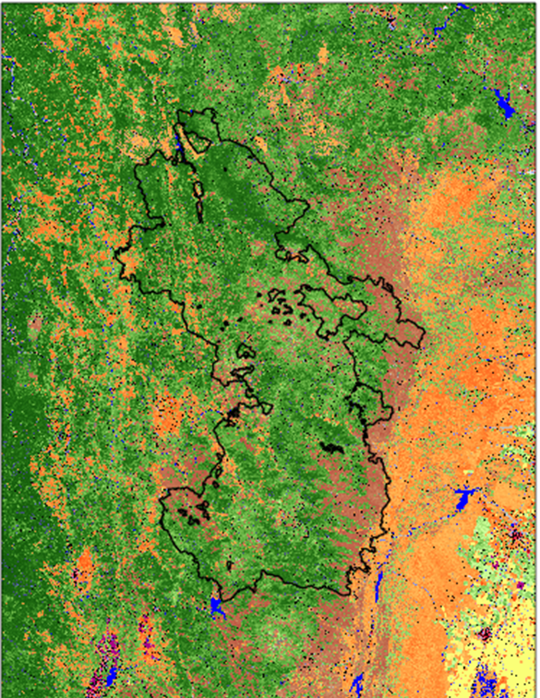
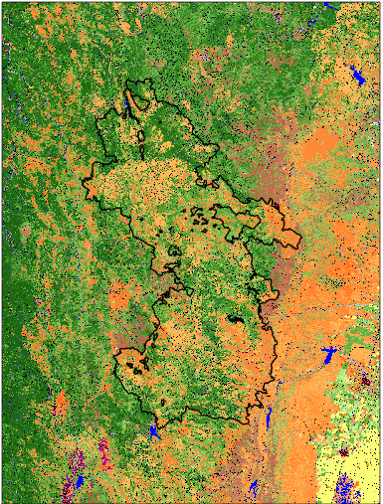
What is the situation? Spatial Context
Existing Vegetation Cover
LF 2016 Remap
LF 2020
Annual Disturbance
Notes:
Vegetation cover 2016 vs 2020 reduced tree cover with landfire rulesets derived originally from FVS.

Slide 21
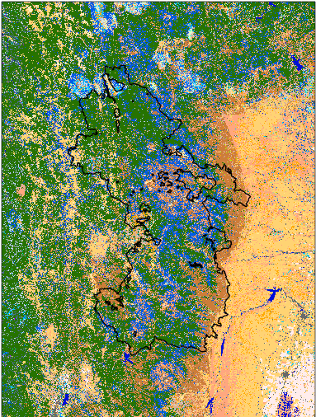
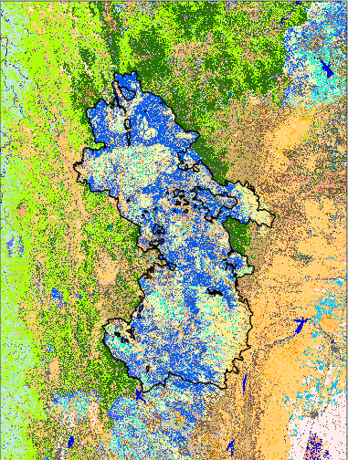
What is the situation? Spatial Context
FBFM40 Fuel Models
LF 2016 Remap
LF 2020
Annual Disturbance
Notes:
Fuelscape 2016 vs 2020 More than just the fire changed…due to fuels calibration in California where fire behavior fuel models indicating flame length and rate of spread for surface fuels were adjusted to better represent what experts agreed upon. However, biggest difference within the fire perimeter.

Slide 22
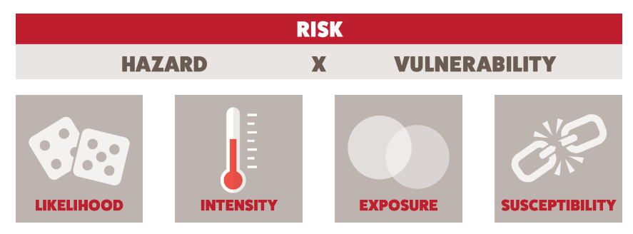
What is the situation? Relative Risk
wildfirerisk.org
Notes:
FSim using landfire fuels, topography
WRC and NE WRAP using FSim results

Slide 23
What is the situation? Relative Risk
LANDFIRE– FUELS AND TOPOGRAPHY
FIRE BEHAVIOR MODEL
BURN PROBABILITY
FLAME LENGTH
LIKLIHOOD
INTENSITY
HAZARD!
Notes:
LF provides fuel layers or landscape files for fire behavior models used by insurance industry, private startups, non-profits and government.

Slide 24
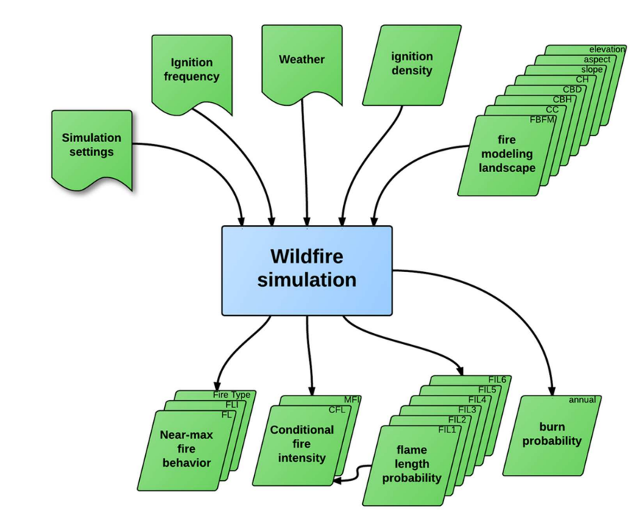
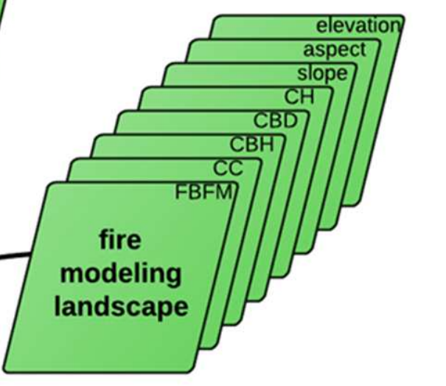
What is the situation? Relative Risk
Notes:
Example is the large fire Simulator Fsim – landscape level

Slide 25
LANDFIRE layers
All lands in United States and insular areas at the 30m pixel level
Disturbance
Annual (every year)
Historical Disturbance (10 years)
Fuel Disturbance
Topographic
Slope (deg)
Slope (%)
Aspect
Elevation
Vegetation
Existing Vegetation Type (ES and NVC)
Existing Vegetation Cover Existing Vegetation Height
Biophysical Settings
Fuels
13 Anderson Fire Behavior Fuel Models
40 Scott and Burgan Fire Behavior Fuel Models
Fuel Characteristic Classification System
Canopy Cover
Canopy Height
Canopy Bulk Density
Canopy Base Height
Fuel Vegetation Type
Fuel Vegetation Cover
Fuel Vegetation Height Mod-FIS
Fire Regime
Succession Class
Vegetation Departure Index
Vegetation Condition Class
Fire Regime Group
Fire Return Interval
Percent Replacement Severity Fire
Percent Mixed Severity Fire
Percent Low Severity Fire
Reference
Reference Database (plots)
Events Geodatabase (polygons)
Notes:
These are the eight layers used in most fire behavior models in some capacity.

Slide 26
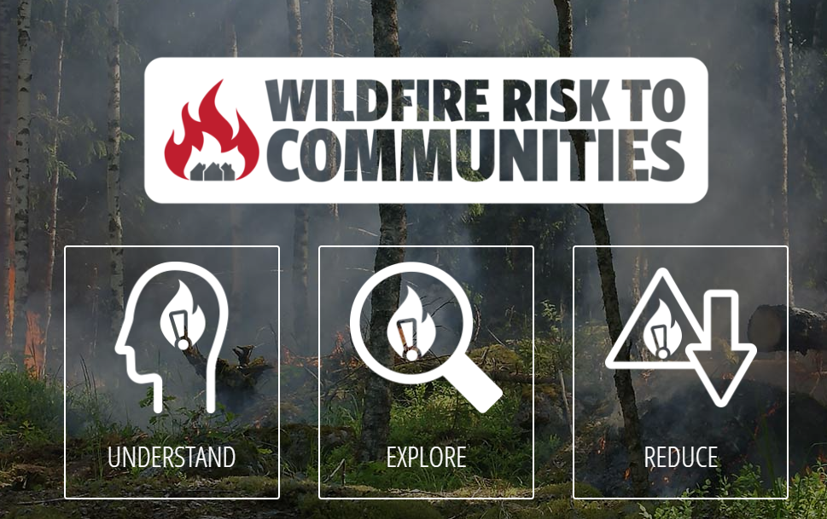
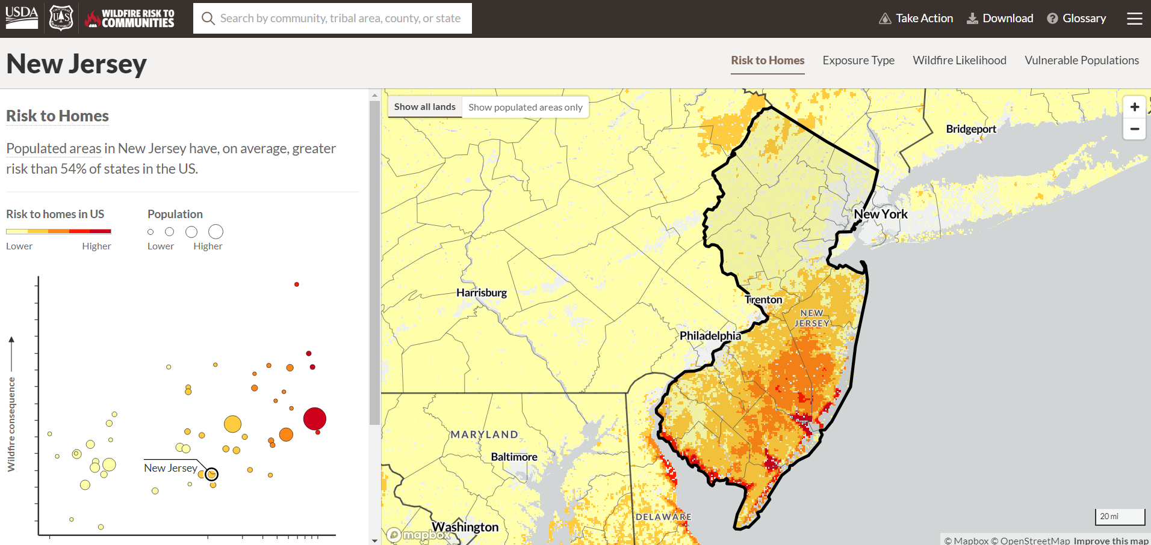
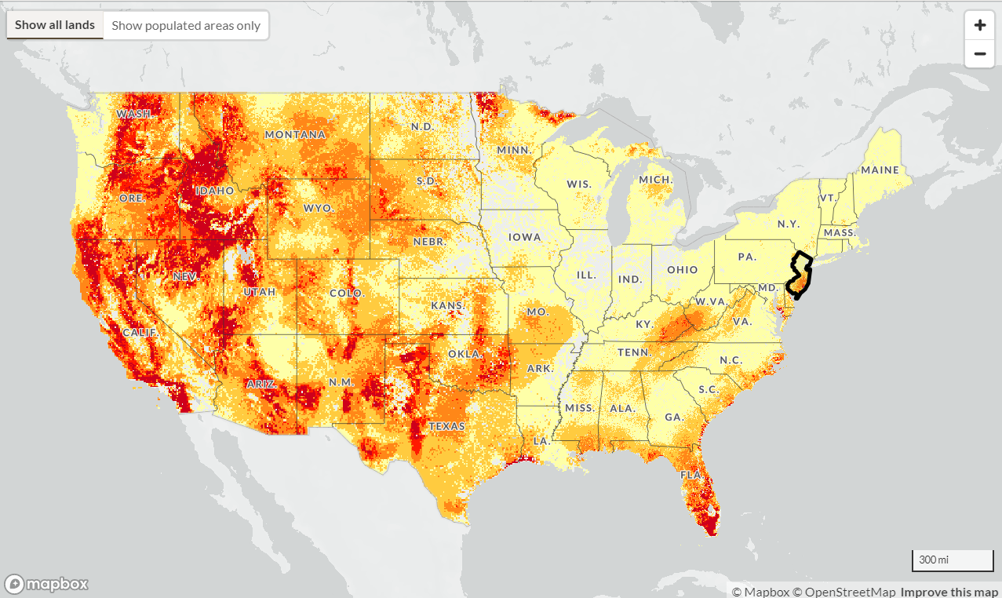
What is the situation? Relative Risk
wildfirerisk.org
Notes:
USFS wildfire risk to communities Riley Finney out of Missoula Fire Lab LF2014 now–updating to use LF2020 data.

Slide 27
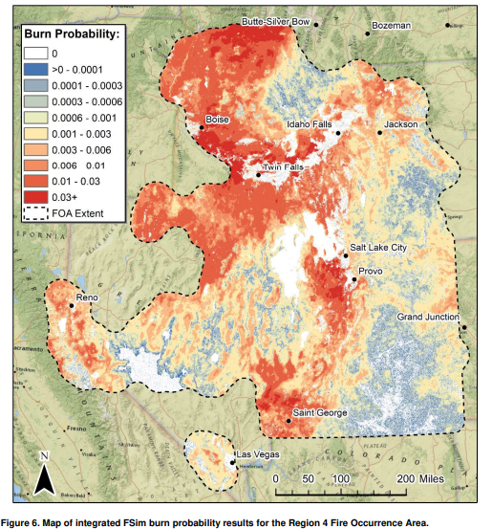
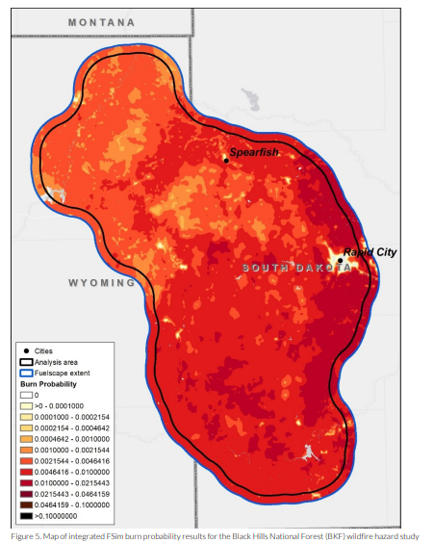
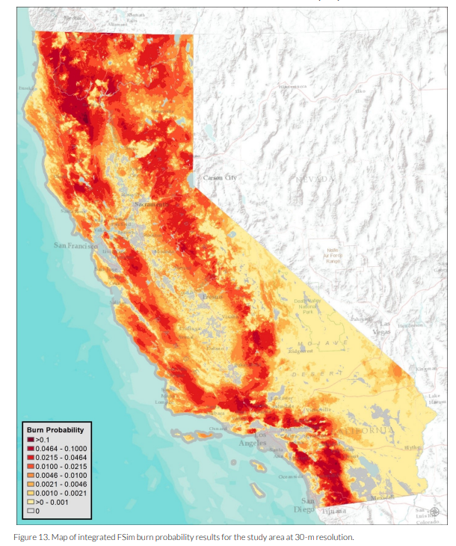
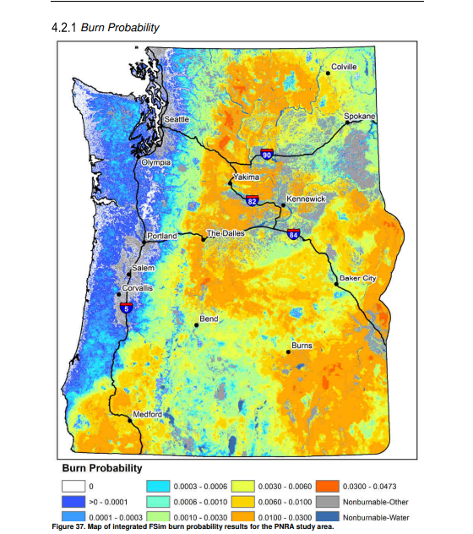
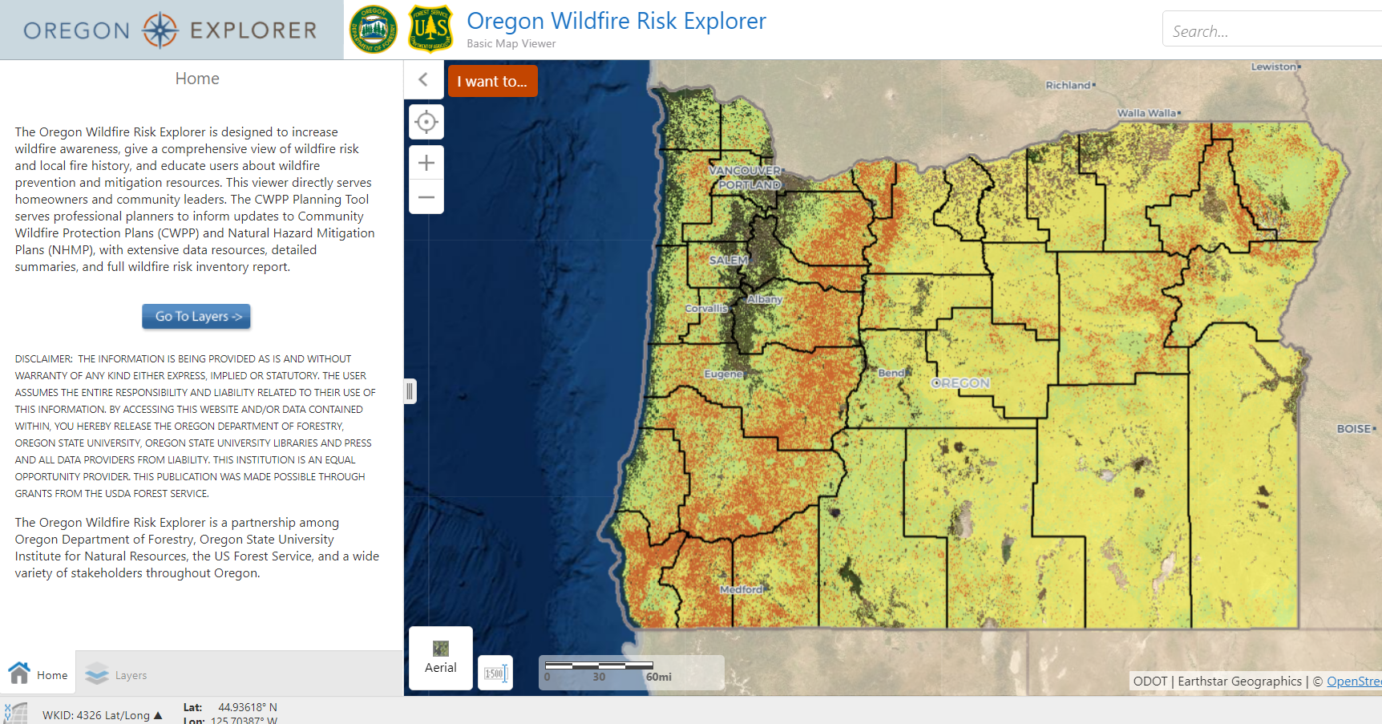
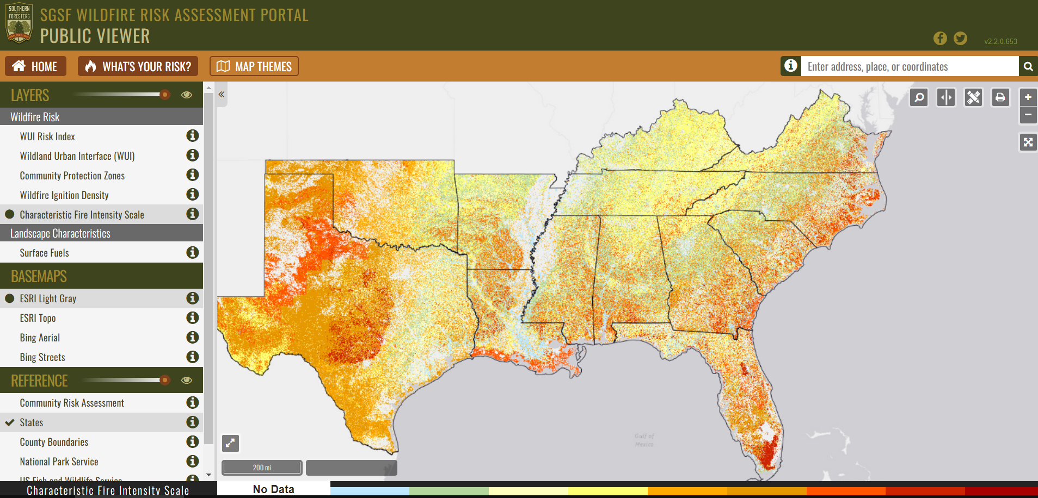
What is the situation? Relative Risk
Other Fsim applications using LANDFIRE data
Notes:
NEMW state foresters wildfire risk assessment with LF2016 data came out in 2021. Southern Group of State Foresters. PNW USFS 2018 version. Oregon has a portal for this info (pre – new law and rejection of new map) ---it goes on and on…CA pilot, Region 4, and Black Hills National Forest. Reports out of Pyrologix that runs the Fsim model for many regions.

Slide 28
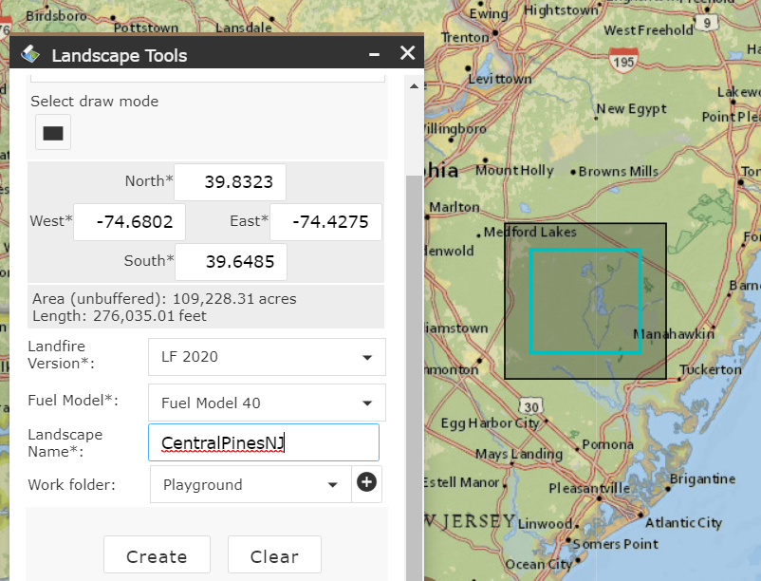
Prioritize AND understand risk using LANDFIRE in IFTDSS
IFTDSS- Interagency Fuel Treatment
Decision Support System
All online!
iftdss.firenet.gov
Notes:
IFTDSS uses Flammap, another fire behavior fuel model that requires LANDFIRE and you input wind direction and strength - Has fuel treatment effectiveness monitoring and reports

Slide 29
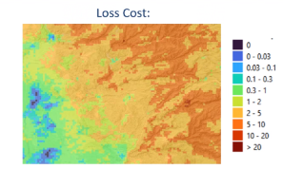
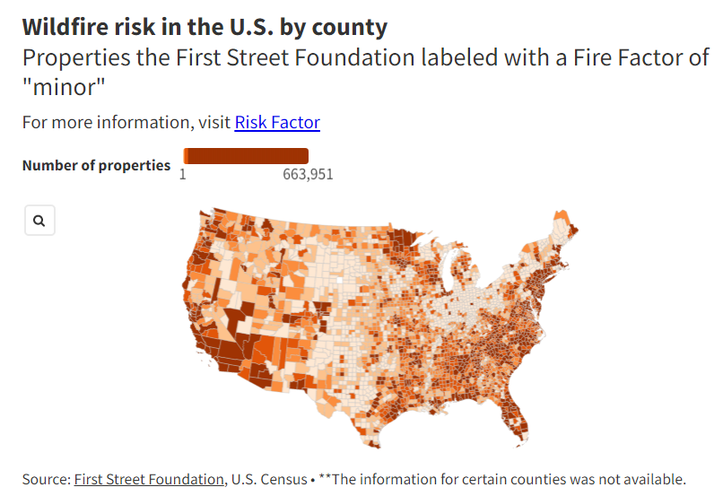
More risk applications using LANDFIRE
Private/Non-profit
Academic
www.karenclarkandco.com
ral.ucar.edu
Firststreet.org
Notes:
Insurance (Karen Clark and Company)- use proprietary model with LF inputs for fuels and nine climate change scenarios; Non-profit First Street Fire Factor using ELMFIRE model, LEAP-HI NSF/NCAR program uses LANDFIRE surface fuel models for the WRF-Fire Model- currently 13 but soon 40

Slide 30
Overview
Restore and Maintain Landscapes
What is the situation?
Spatial context Relative risk
Fire Adapted Communities
What can I do about it?
Local conditions Community engagement
Response to Fire
Who can help me?
Help from outside Operational decisions

Slide 31
Fire Adapted Communities: What can I do about it?
CWPPs need maps of fuels and risk to prioritize treatment areas. Most use LF data to determine that.
Notes:
Grant money - Greater Lemon used LF layers and WFDSS fire behavior – this is one fire protection district in CO – These are done for 100’s of municipalites

Slide 32
What can I do about it?
https://www.usfa.fema.gov/downloads/pdf/publications/creating_a_cwpp.pdf
https://fireadapted.org/cwpp-database/
Notes:
These are done for 100’s of municipalities – this map came from the fireadapted.org and only covers the 11 western states. There are MANY CWPPs in the east as well! FEMA report recommends use of LANDFIRE for CWPP fuel mapping.-----add link to FAC website.

Slide 33
What can I do about it?
Notes:
Firewise NFPA--- bringing it home….risk in my neighborhood, start looking at pixels surrounding homes/neighborhood. Prioritizing firewise efforts at the yard level.

Slide 34
What can I do about it?
Notes:
Firewise NFPA--- bringing it home….risk in my neighborhood, start looking at pixels surrounding homes/neighborhood. Prioritizing firewise efforts at the neighborhood/yard level.

Slide 35
Overview
Restore and Maintain Landscapes
What is the situation?
Spatial context Relative risk
Fire Adapted Communities
What can I do about it?
Local conditions Community engagement
Response to Fire
Who can help me?
Help from outside Operational decisions

Slide 36
Response to fire: Who can help me?
Wildland Fire Decision Support System WFDSS used for strategic and tactical decisions for fire incidents.
This decision support system is intended to assist wildland fire managers in assessing risks and fire behavior during an event.
Included in WFDSS | Included in WFDSS
Tools | Basic Fire Behavior | Short-Term Fire Behavior | Near-Term Fire Behavior | Fire Spread Probability
Spread Model | Flammap Grid | Minimum Travel Time | FARSITE | Minimum Travel Time
Duration | Snapshot in time | 1 to 3 days | 1 to 7 days | 7 to 30 days
Weather | Daily, constant | Daily, constant | Hourly, variable | Hourly, variable
Data Source | LANDFIRE LCP | LANDFIRE LCP | LANDFIRE LCP | LANDFIRE LCP
Output | Raster display of fire behavior | Major flow paths, arrival times | Perimeter, fire behavior rasters | Probability surface
Notes:
Where to put resources- how to fight the fire – which way is it heading?---how many assessments were completed using WFDSS?

Slide 37
Why are LF fuels used on incidents?
LANDFIRE uses similar models to check our inputs against actual fire spread
LANDFIRE incorporates local calibrations and expert input
Changes in fuels are accounted for (disturbance)
LANDFIRE provides tool to adjust fuels with local knowledge
Seamless all-lands 30m, nationally consistent
Fire behavior analysts KNOW that they will have LANDFIRE anywhere they go
Notes:
We use the same models to compare to actual fire spread to improve our fuels data. Flammap Farsite run. Same methods across CONUS etc.

Slide 38
Who can help me?
LANDFIRE vegetation and topography.
Pre-work: POD is a spatial container bounded on all sides by usable fire control features.
Treemap imputation
LANDFIRE fuels and topography
Snag Hazard
Flammap
Accessibility and Fire Line Production Rate
Fire Behavior Metrics
Suppression Difficulty Index
Potential Control Lines
Potential Operational Delineation (POD)
Notes:
Suppression Difficulty Index uses and SDI is used to create PODs,– “none of this would be possible without LANDFIRE” – quote from Kit O’Connor
Meters per minute- PCL 2017 paper, 2020 SDI update, 2014 wildfire hazard potential Dillon PCL resistance to control

Slide 39
Who can help me?
Notes:
Suppression Difficulty Index uses and SDI is used to create PODs, Snag hazard map derived from Treemap which used LF data – “none of this would be possible without LANDFIRE” – quote from Kit O’Connor

Slide 40
Conclusions
Restore and Maintain Landscapes
What is the situation?
Spatial context – LF disturbance, veg and fuels Relative risk – Risk analyses use LF
Fire Adapted Communities
What can I do about it?
Local conditions – CWPP’s use LF Community engagement – Firewise uses LF
Response to Fire
Who can help me?
Help from outside – WFDSS uses LF Operational decisions – PODs uses LF
Foundational LANDFIRE data matters to the Cohesive Strategy!

Slide 41
Planning ahead
Annual releases
Fiscal year disturbance
Incremental release
Remap like updates
Cloud processing
Notes:
Annual releases accounting for disturbances in the year before. Lines between base map and updates are getting blurred.

Slide 42
Stay in touch
@nature_LANDFIRE
LANDFIREvideo
LANDFIRE Brief
https://landfire.gov
Notes:
For chat:
YouTube: https://www.youtube.com/user/landfirevideo
LANDFIRE Brief: http://eepurl.com/baJ_BH
Twitter: https://twitter.com/nature_LANDFIRE
LF Homepage: https://landfire.gov/

Slide 43
Join our Office Hour
What: Once a month opportunity to interact directly with LANDFIRE Production team and TNC LANDFIRE experts.
Featured LANDFIRE User
Get questions answered
See how others are using LANDFIRE data / products
When: Last Wednesday @ 1 pm ET
(except July, Aug)
How: Register here
Notes:
Register: https://tnc.zoom.us/meeting/register/tJIocumupzMpEtN63X--Or1r6CJej683Bp5E

Slide 44
Acknowledgements
ENTIRE LANDFIRE TEAM
USDA FS, DOI, USGS, TNC, KBR, ASRC
MANAGERS: HENRY BASTIAN, JIM MENAKIS, TIM HATTEN, JIM SMITH, MARCI HYSER
NJ FOREST FIRE SERVICE
NE RSC – LARRY MASTIC
For more information:
CONTACT ME- INGA LA PUMA: ilapuma@contractor.usgs.gov
LANDFIRE HELPDESK: helpdesk@landfire.gov
DOWNLOAD DATA: https://landfire.gov/getdata.php
Notes:
TSSC = about 15 full time core folks that help to create the product and deliver it and another 5-10 part time as needed.
Separate out into ack, and for more info: ADD IN THE CONSERVATION GATEWAY

Slide 45
Interactive Action Plan
Every map is a masterpiece
of visual storytelling.
Group 1: What challenges do you face in landscape level risk and priorities?
Group 2: What challenges do you face with local planning/assessments?
Group 3: What challenges do you face operationally?
How might your challenges tie back to LANDFIRE?
Notes:
ACTION PLAN!
Based on what you just saw – what info do you need LANDFIRE to reflect to meet these goals?
Ask them what the challenges are that tie back to LF and how can we help.
Do you need training, what methods to use to address questions, are there applications to help address your issues.
Calibration for your area
Have you been to our website?
Builds on the story.
How the data is being used….are you providing data – can we get it?
Prior to this presentation how aware were you of LF as the driver?
Here is where you get LF data. Do you know where to get it?
Speak from the manager perspective on this!
How can we help LF improve their data?

